Slide 1


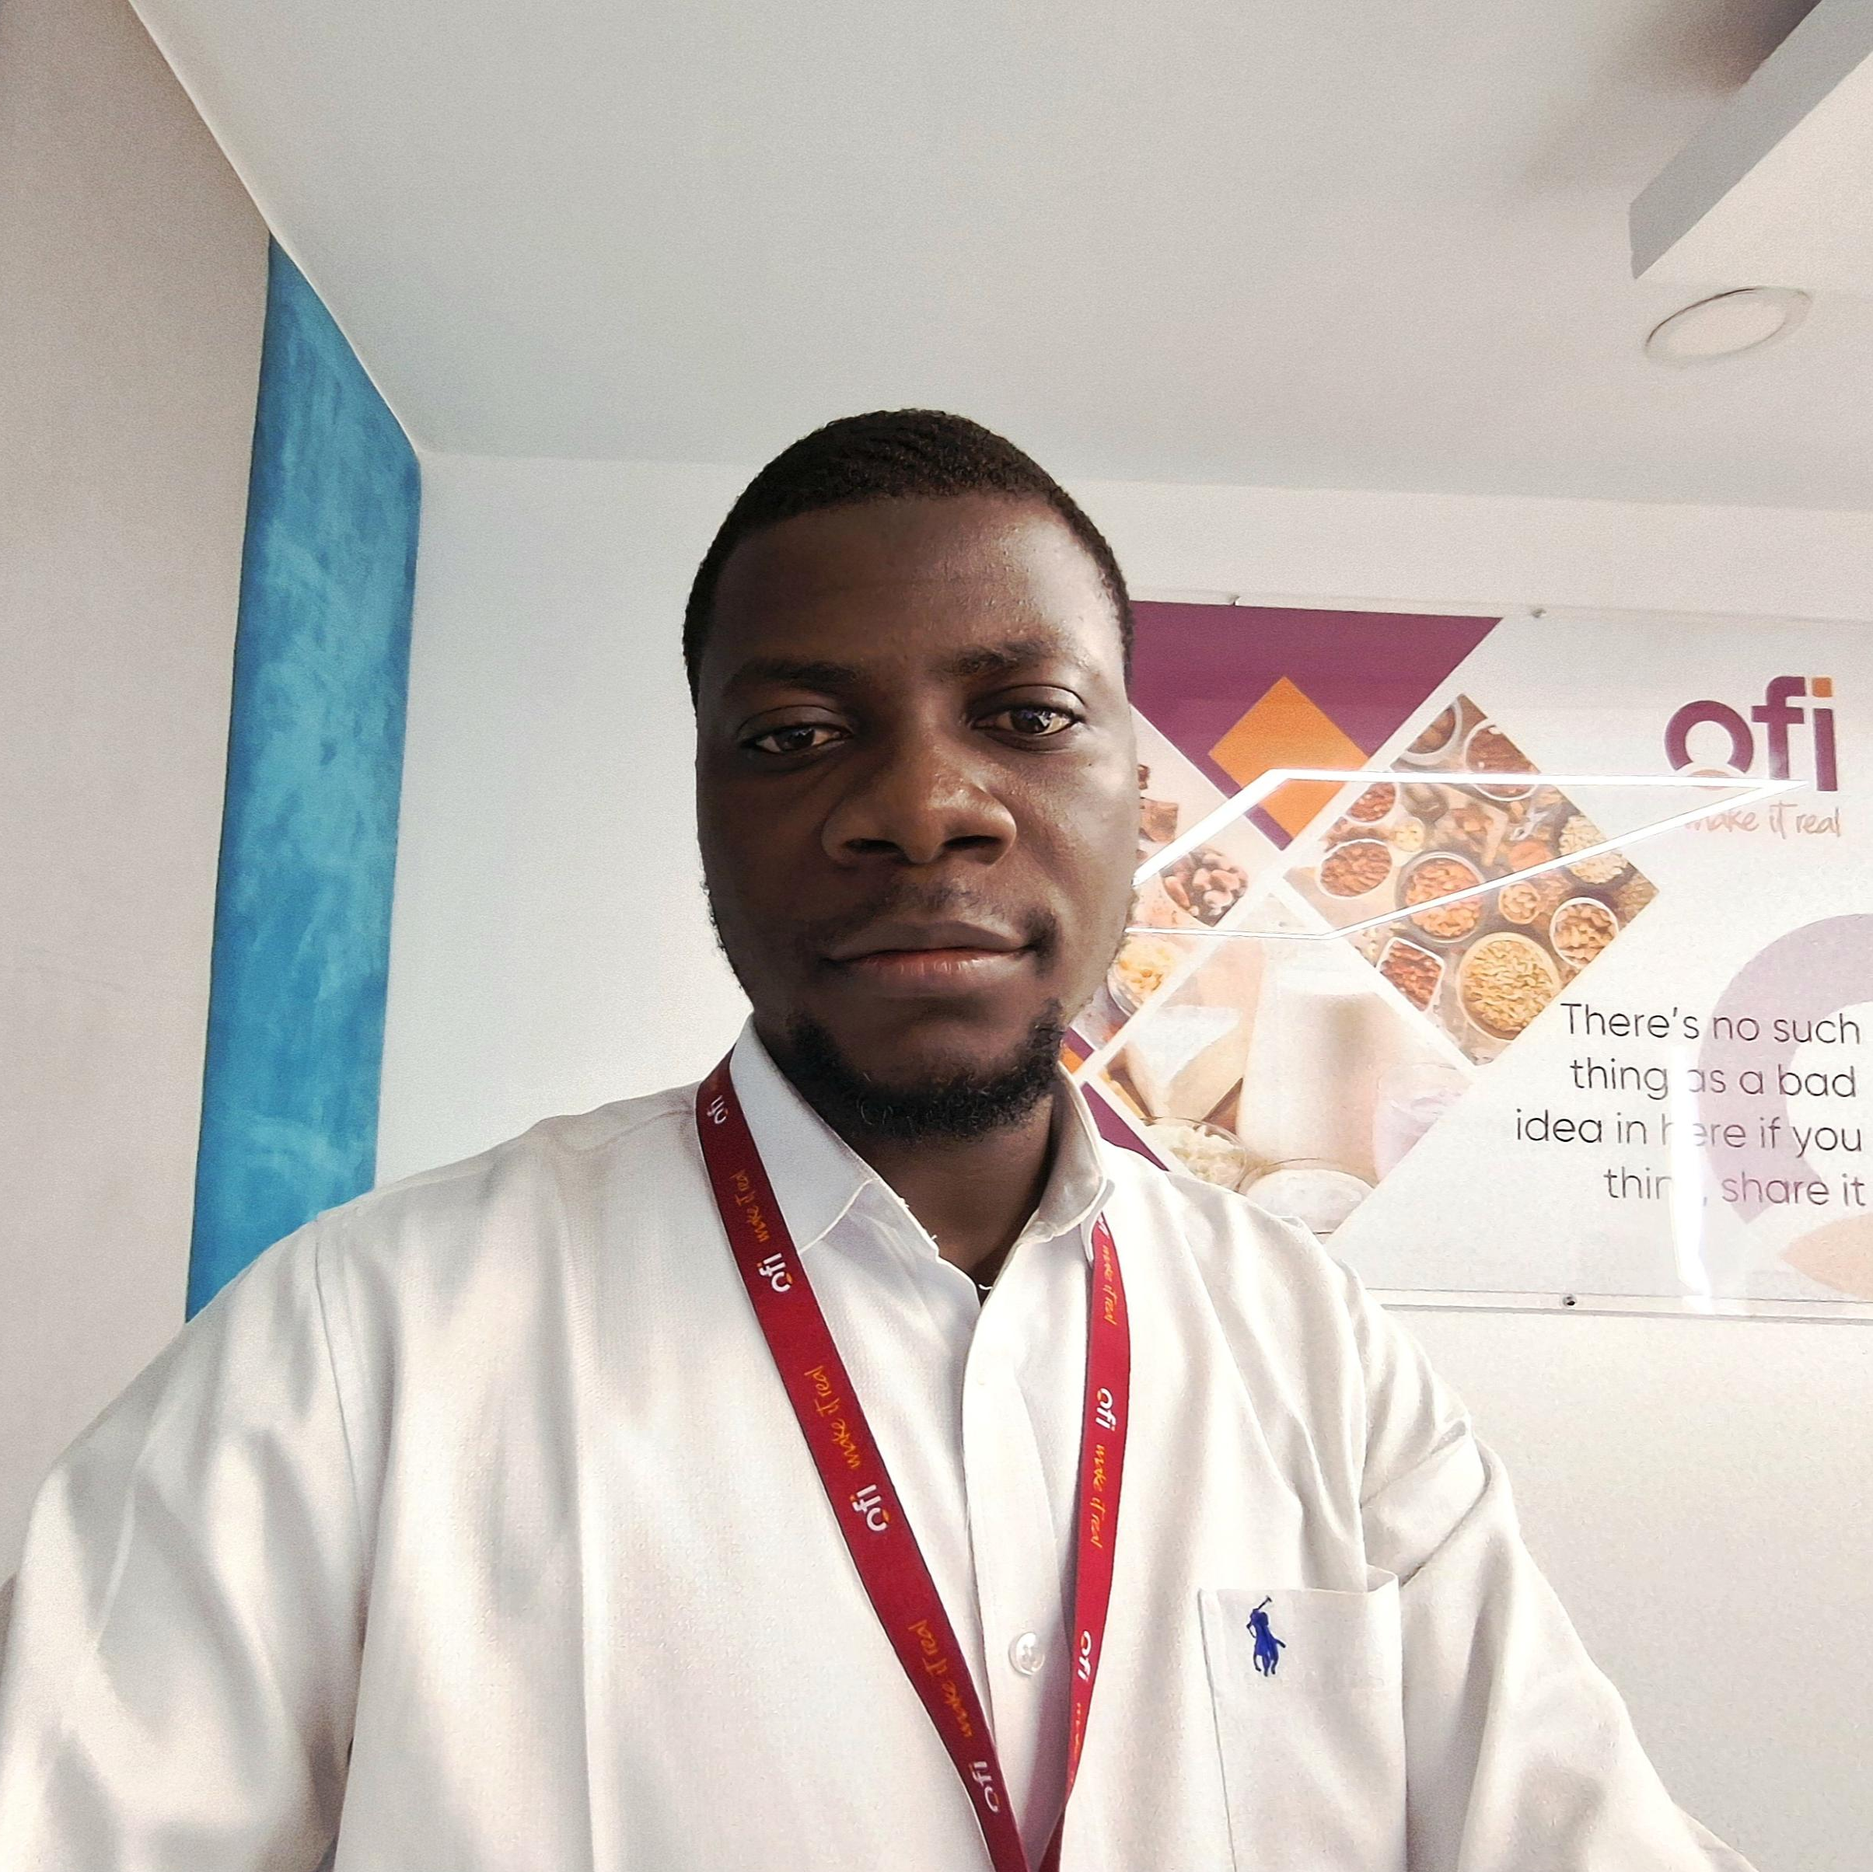
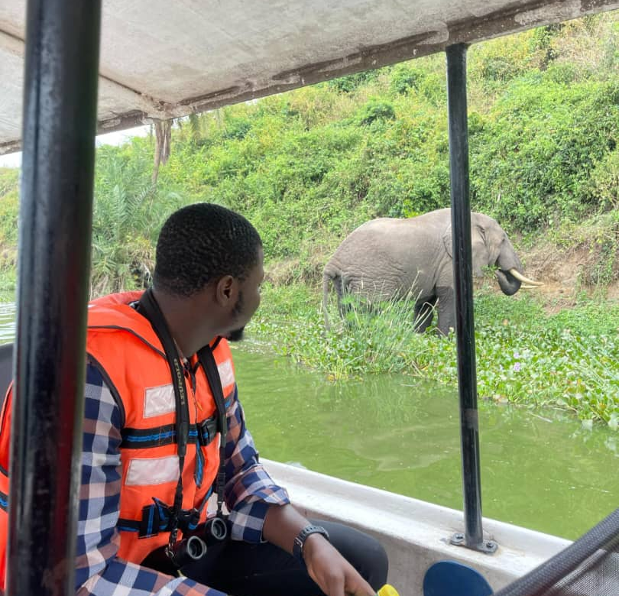
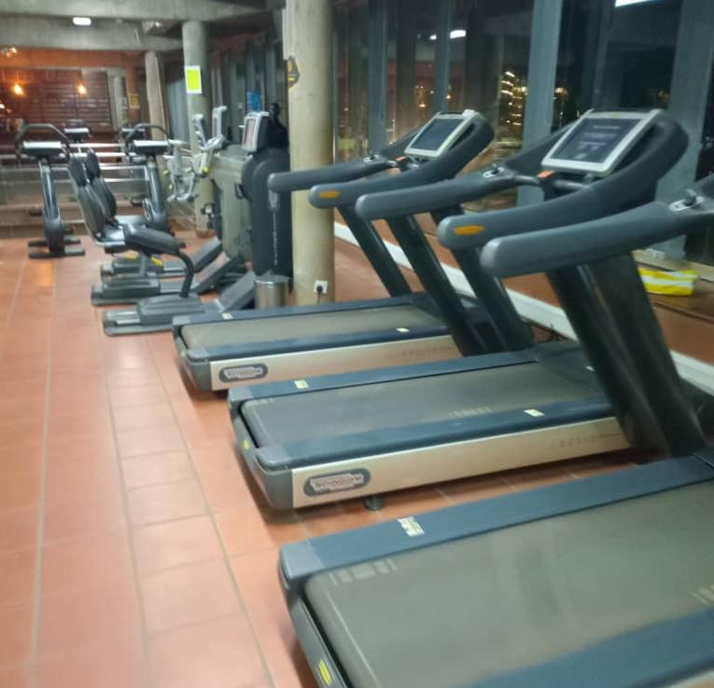
Getting to Know Me
Work
Personal
My role
Procurement Executive
Significant others / family members / furry friends in my life
Nuclear Family
Tenure in ofi/Olam
1.5 Years
How I enjoy spending my free time
Playing Video Games
Previous companies I have worked at
Mallam Aminu Kano International Airport
My favorite / comfort food
Local Rice
Why I joined ofi/Olam and what keeps me here?
Ownership
My favorite song
99 Names of Allah – Coke Studio
Najimdeen Yoonus
Yoonus
A few fun facts about me
I love watching Sitcoms
This is me outside work, doing stuff I enjoy in my life …

